Slide 1
Java Methods

Slide 2
In Java, a method is a function that belongs to a class.
Every function belongs to a class.
A function is a reusable portion of a program, sometimes called a procedure or subroutine.
Like a mini-program (or subprogram) in its own right
Can take in special inputs (arguments)
Can produce an answer value (return value)
Similar to the idea of a function in mathematics
Why write and use functions?
Divide-and-conquer
Can breaking up programs and algorithms into smaller, more manageable pieces
This makes for easier writing, testing, and debugging
Also easier to break up the work for team development
Reusability
Functions can be called to do their tasks anywhere in a program, as many times as needed
Avoids repetition of code in a program
Functions can be placed into libraries to be used by more than one "program"
With methods (functions), there are 2 major points of view
Builder of the method -- responsible for creating the declaration and the definition of the method
Caller -- somebody (i.e. some portion of code) that uses the method to perform a task

Slide 3

Now you will learn how to create your own methods with or without return values, invoke a method with or without parameters, overload methods using the same names, and apply method abstraction in the program design.
Example of a method
public static : modifier.
int: return type
funcName: function name
int a, int b: list of parameters (formal parameter list)

Slide 4

Methods are also known as Procedures or Functions:
Procedures: They don't return any value.
Functions: They return value.
The syntax
The syntax shown above includes:
modifier: It defines the access type of the method and it is optional to use.
returnType: Method may return a value.
nameOfMethod: This is the method name. The method signature consists of the method name and the parameter list.
Parameter List: The list of parameters, it is the type, order, and number of parameters of a method. These are optional, method may contain zero parameters.
method body: The method body defines what the method does with statements.

Slide 5
void methods and empty parameter lists
Parameter lists
Mathematical functions must have 1 or more parameters
Java methods can have 0 or more parameters
To define a method with no parameters, leave the parentheses empty
Same goes for the call. (But parentheses must be present, to identify it as a method call)
Return types
A mathematical function must return exactly 1 answer
A Java method can return 0 or 1 return value
To declare a method that returns no answer, use void as the return type
A void method can still use the keyword return inside (this is optional), but not with an expression (only by itself). One might do this to force early exit from a method.
To CALL a void method, call it by itself -- do NOT put it in the middle of any other statement or expression
Sample prototypes:
char getALetter() // no parameters
void printQuotient(int x, int y) // void return type
void killSomeTime() // both

Slide 6
Scope of Identifiers
The scope of an identifier (i.e. variable) is the portion of the code where it is valid and usable
A variable declared within a block (i.e. a compound statement) of normal executable code has scope only within that block.
Includes method bodies
Includes other blocks nested inside methods (like loops, if-statements, etc)
Does not include some special uses of block notation to be seen later (like the declaration of a class -- which will have a separate scope issue)
Variables declared in the formal parameter list of a method definition have scope only within that method.
These are considered local variables to the method.
Variables declared completely inside the method body (i.e. the block) are also local variables

Slide 7
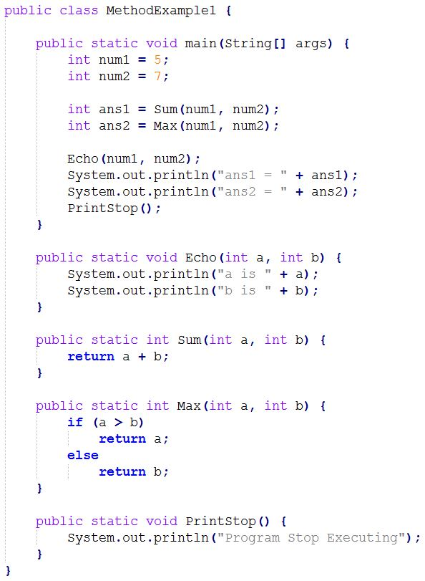
Process of method calling
When a program invokes a method, the program control gets transferred to the called method.
This called method then returns control to the caller in two conditions, when:
1. return statement is executed.
2. reaches the method ending closing brace.

Slide 8
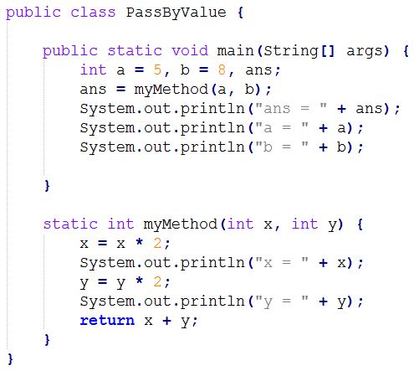
Pass By Value. It is the default mode of passing parameters into methods
Means that the parameter inside the method body is a copy of the original argument that was passed in
Changes to the local parameter only affect the local copy, not the original argument in the call

Slide 9
Method Overloading
The method signature consists of the method name and the parameter list
The term method overloading refers to the fact that it is perfectly legal to have more than one method in the same class with the same name, as long as they have different parameter lists. The difference can be in the number of parameters, or in the types of parameters.
Example:
int process(double num) { } // method 1
int process(char letter) { } // method 2
int process(double num, int position) { } // method 3
Notice that although all three methods above have the same exact name, they each have a different parameter list. Some of them differ in the number of parameters (2 parameters vs. 1 parameter), and the first two differ in types (double vs. char). The compiler will distinguish which function to invoke based on what is actually passed in when the function is called.
x = process(3.45, 12); // invokes the third function above
x = process('f'); // invokes the second function

Slide 10
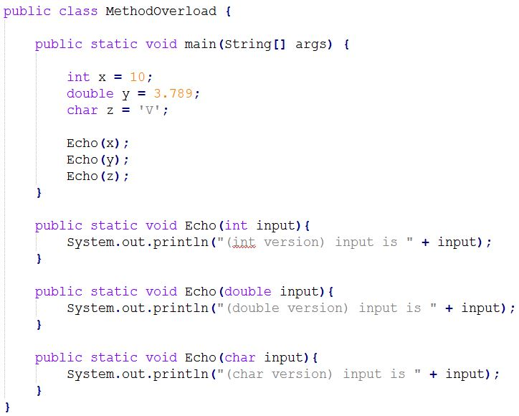
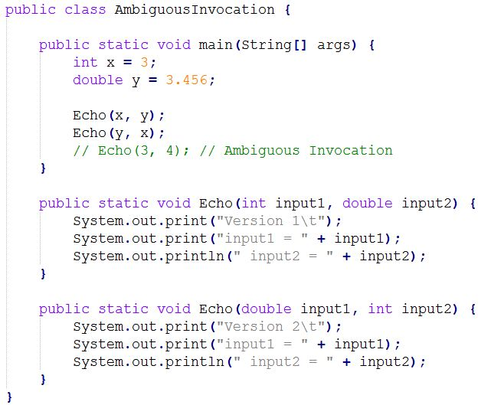

Slide 11
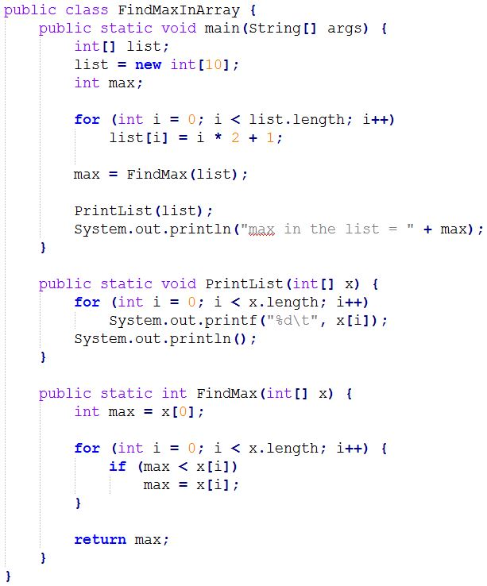
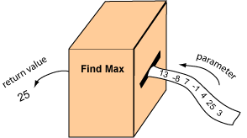
Maximum-finding Method
Say that we want a method that finds the maximum element in an array of integers. Think of this method as a machine that inputs an array and outputs the maximum.
The array is passed into the method as a parameter, and the maximum is returned by the method.

